Slide 1
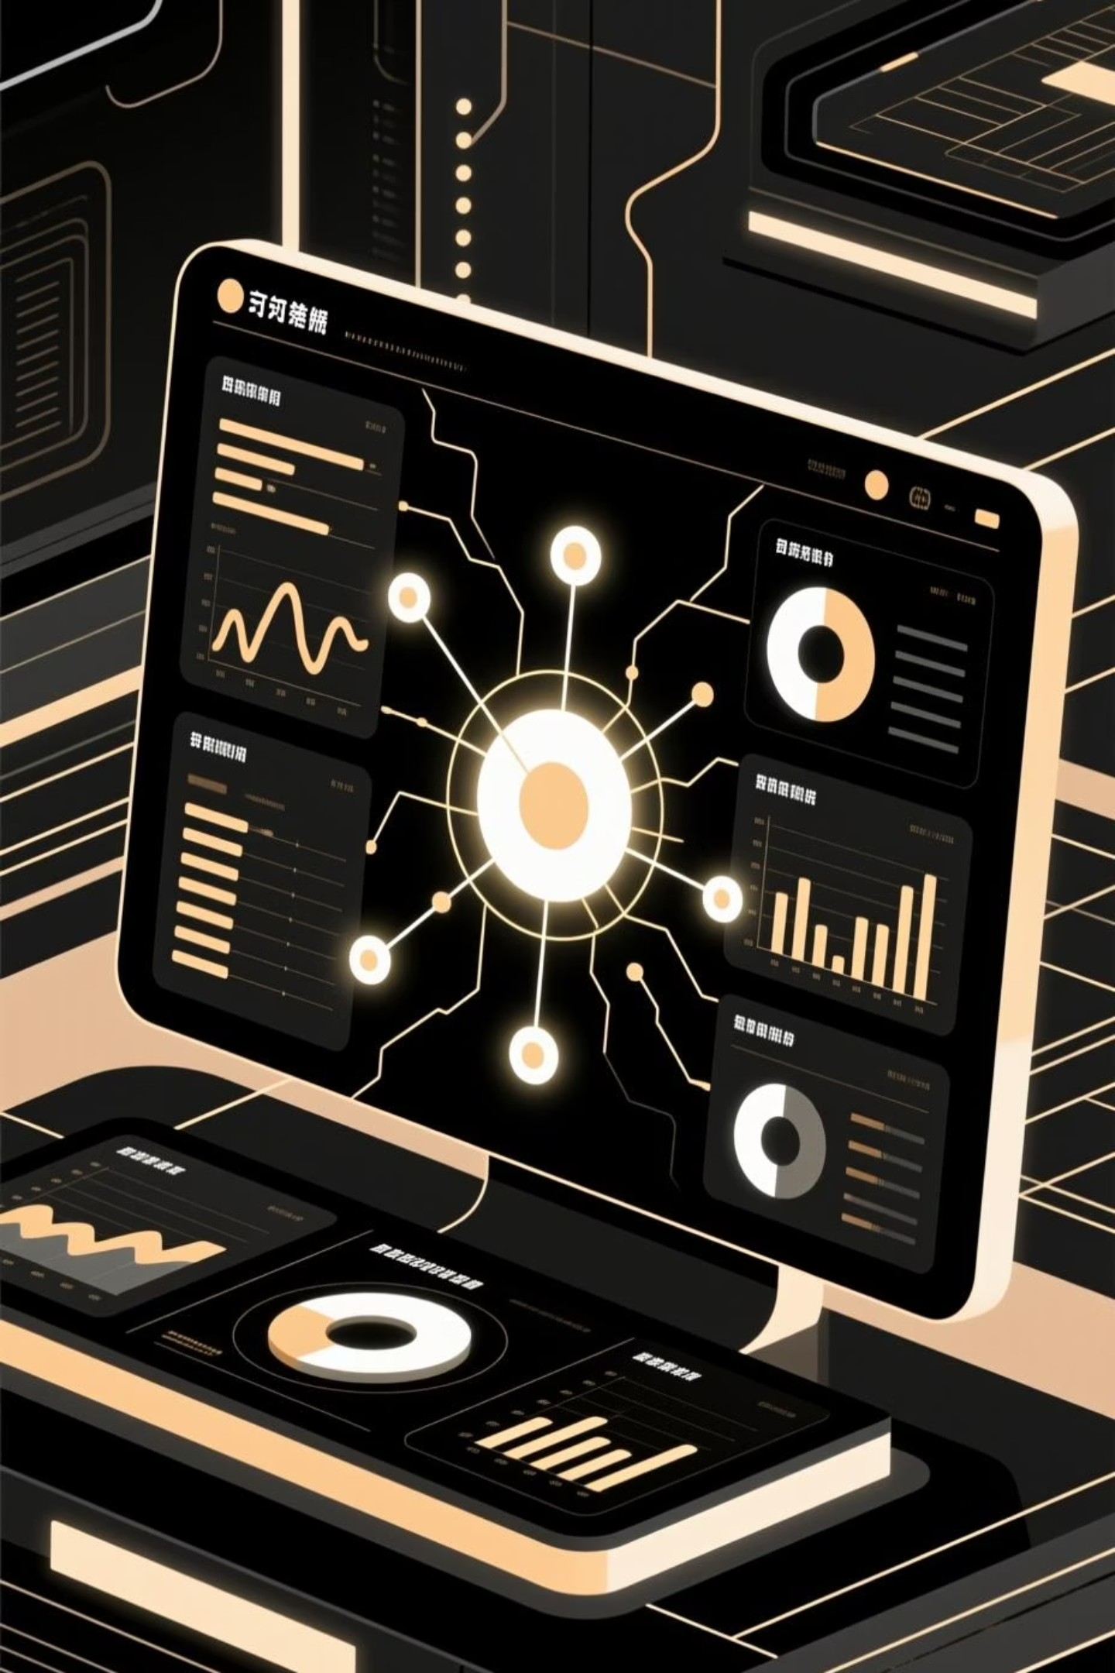
Unlocking Insights: Keyword & Keyphrase Extraction Web Application
In an age of ever-increasing digital content, extracting meaningful insights has become paramount. Our project introduces a sophisticated yet accessible web application designed to distill vast amounts of text into essential keywords and keyphrases.

Slide 2




The Innovators Behind the Project
Rama Chandra Murthy
T.Koushik
AP23110010015
AP23110010234
Chv.Akhilesh Krishna
Sairam Karthik
AP23110010248
AP23110010386
Chaitanya Raju
AP23110010470

Slide 3


Addressing the Deluge: Problem Statement
The sheer volume of digital text today creates significant challenges for information management.
Information Overload
Manual keyword assignment is inefficient and costly, leading to critical insights being missed in the vast sea of data.
Complex Keyphrases
Simple models often fail to capture multi-word keyphrases like "artificial intelligence," reducing content discoverability.
Accessibility Gap
Existing keyword extraction tools are often complex, requiring technical expertise and limiting their use for non-experts.

Slide 4
Project Objectives: Crafting a Smarter Solution
Algorithm Implementation
Web Application Development
Data Persistence
Implement TF-IDF for accurate keyword extraction.
Utilize SQLite for lightweight, persistent storage of user input and analysis history.
Build a Flask-based web application with a clean MVC architecture for intuitive user experience.
Text Classification
User-Friendly Interface
Integrate Logistic Regression for robust classification of input text, enhancing categorization.
Provide a simple, intuitive interface with comprehensive visualization support, such as word clouds and ranked lists.

Slide 5
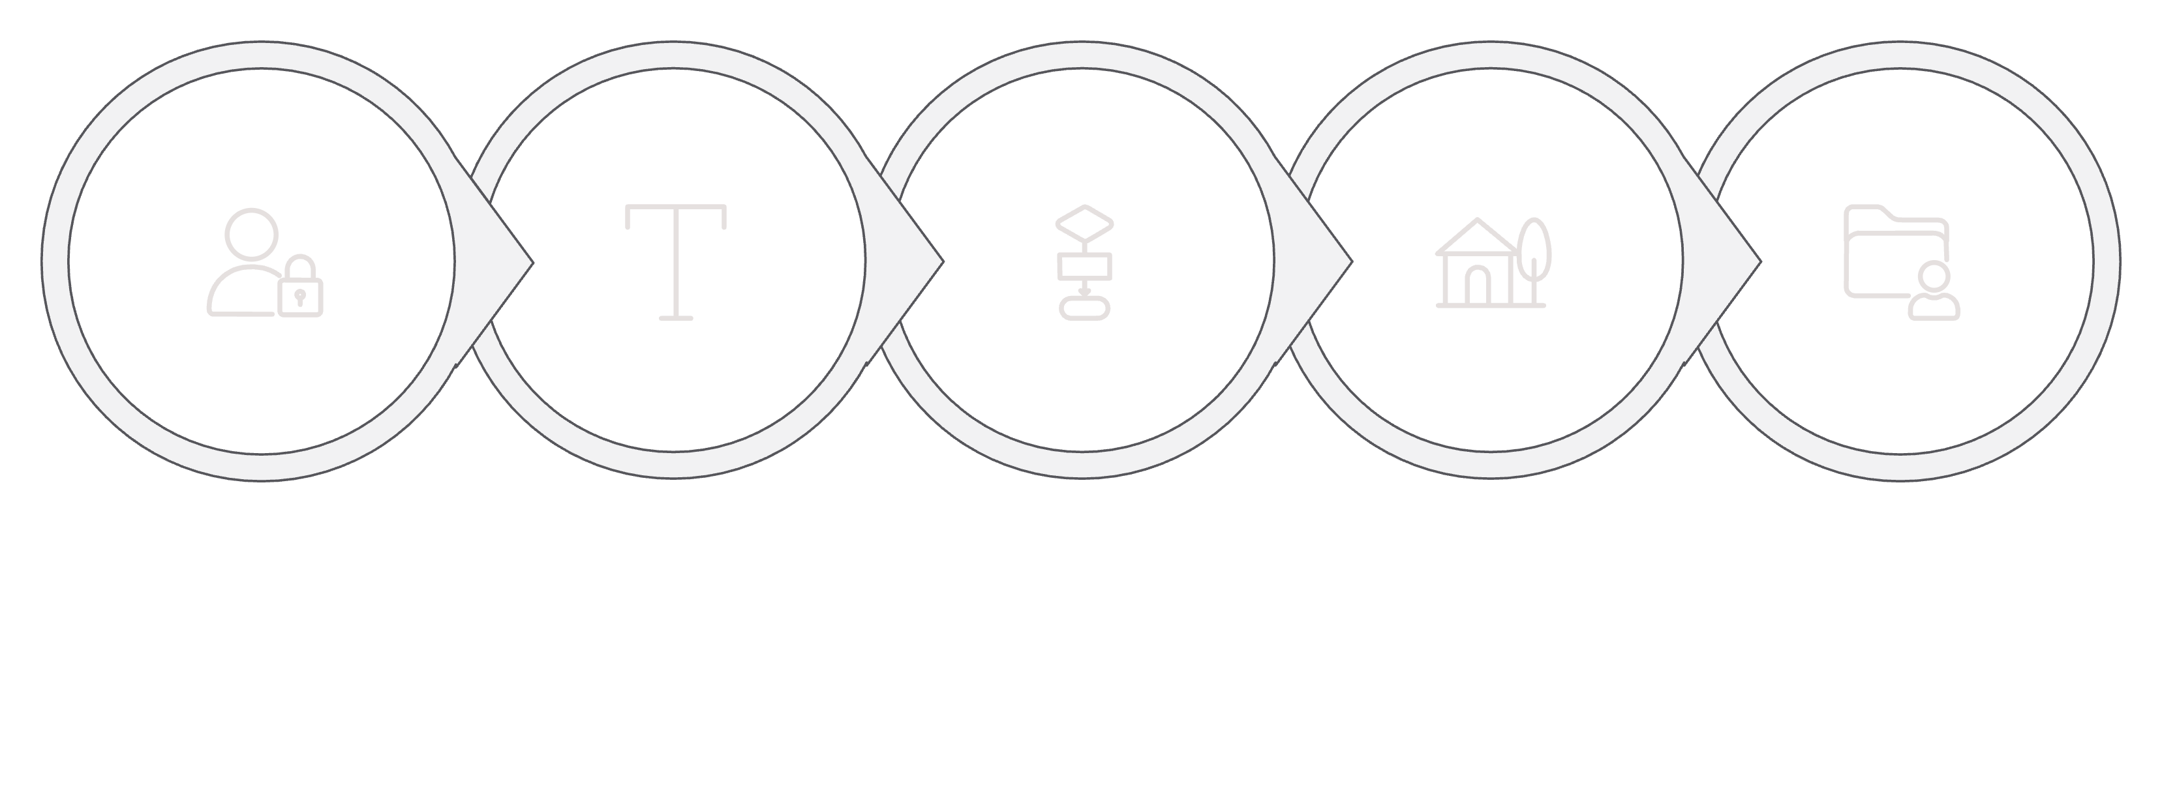





Proposed Solution: An Integrated Workflow
Our web application combines statistical NLP techniques with supervised learning to offer a comprehensive text analysis solution.
Preprocessing
TF-IDF Extraction
Classification
User Input
Store Results
This structured approach ensures accuracy, efficiency, and clarity from input to insightful output.

Slide 6
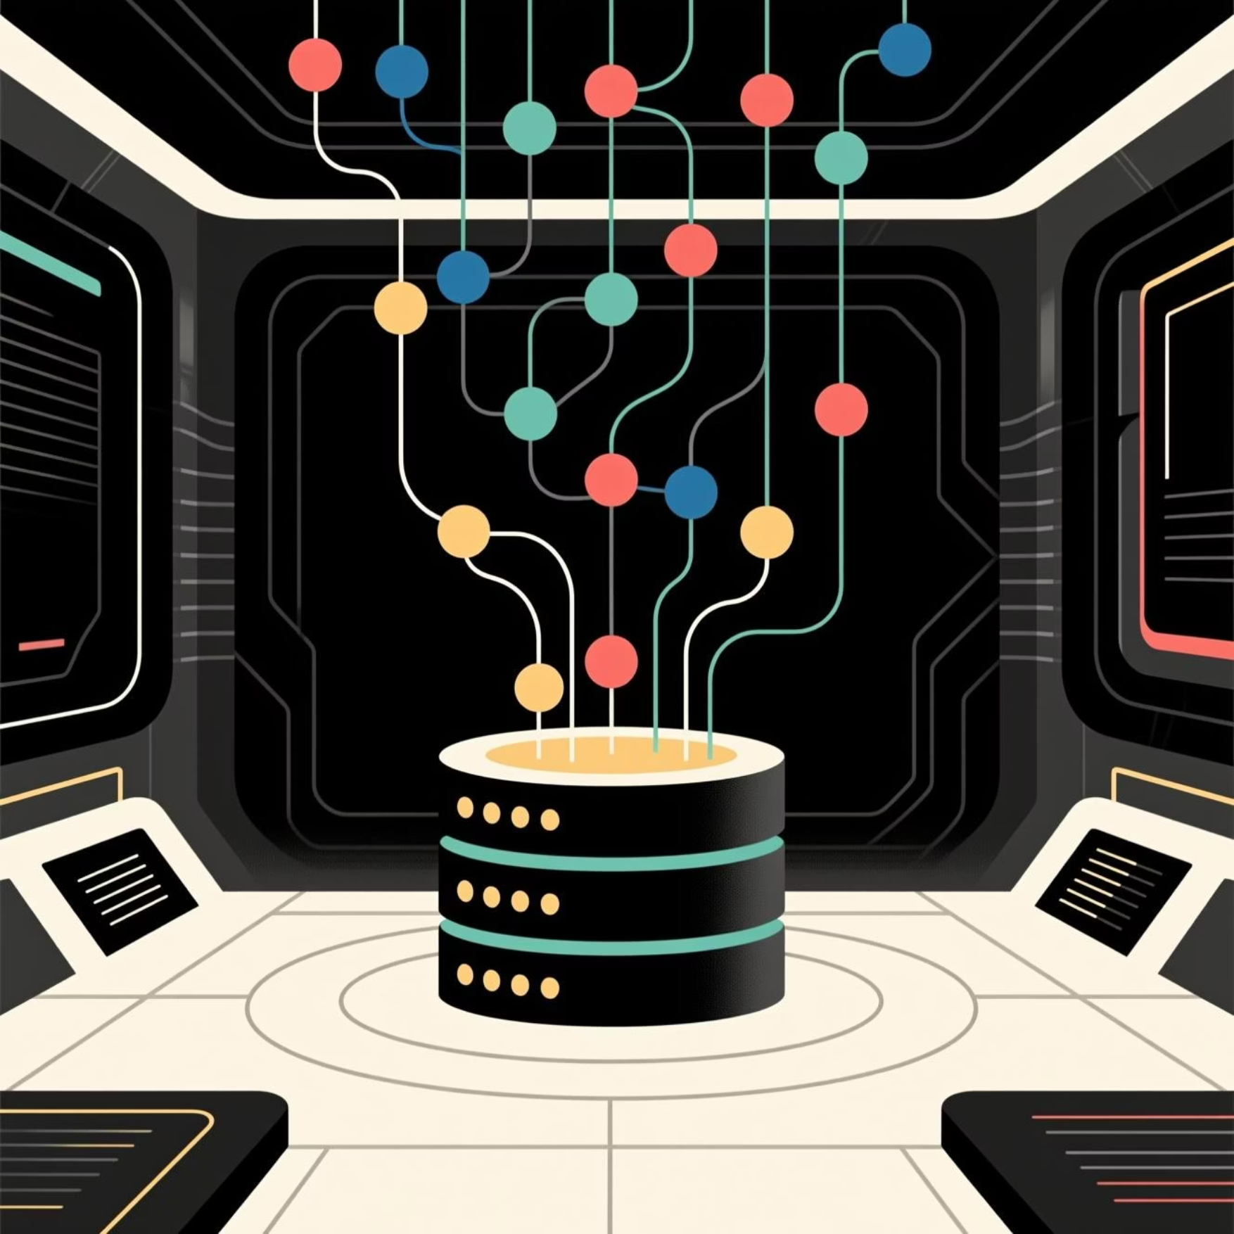
Methodology & Data Foundation
Dataset
Methodology
Single-document inputs provided by the user for on-the-fly analysis.
01
An extensive external corpus supports TF-IDF IDF scoring, ensuring robust term weighting.
Preprocessing
A carefully curated labeled dataset of 1000 Tech vs. Non-Tech articles was used to train and validate our Logistic Regression model.
Rigorous lowercasing, noise removal, tokenization, and stop-word filtering prepare text for analysis.
02
TF-IDF Scoring
Vectorized scoring of token importance identifies high-value individual terms across the corpus.
03
Logistic Regression
Text classification is performed using TF-IDF vectors as features, providing robust content categorization.

Slide 7




Technologies Powering Our Application
Our solution leverages a modern tech stack, ensuring efficiency, scalability, and ease of use.
Python 3.x
Flask
Core language for NLP & ML algorithms.
Lightweight backend web framework.
SQLite
Scikit-learn
Serverless database for history storage.
Key for TF-IDF and Logistic Regression.
HTML5, CSS, Jinja2
Frontend for dynamic and responsive user interfaces.

Slide 8
Performance at a Glance: Results & Findings
Our application demonstrates strong performance in both extraction accuracy and operational efficiency.
Extraction Performance
Classification Results
TF-IDF Strength
94.2%
91.5%
Robust in identifying statistically important single terms, though it naturally separates phrases into individual words.
Training Accuracy
Testing Accuracy
The model exhibits strong probability calibration through its sigmoid function, ensuring reliable classifications.

Slide 9
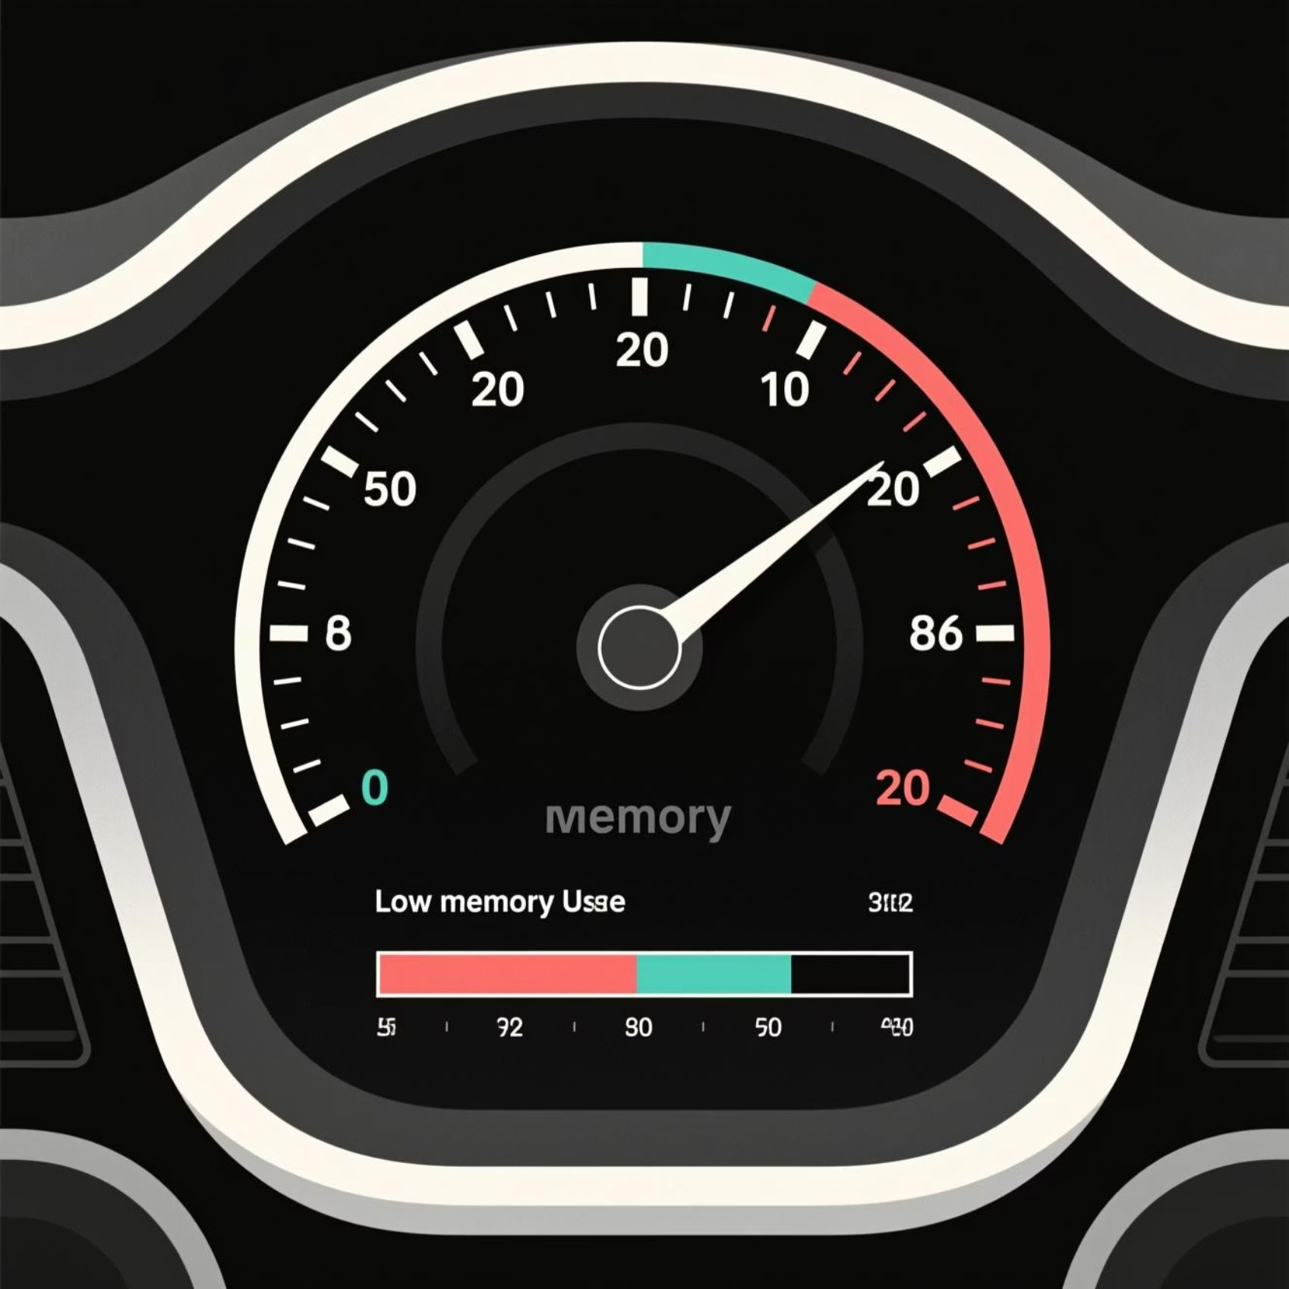
System Performance: Efficiency and Responsiveness
Designed for optimal resource utilization, our application delivers fast and efficient processing.
0.45s
Processing Time
Average time per 1000-word input, ensuring rapid analysis.
< 100MB
Memory Usage
Efficient memory footprint, making it suitable for various deployment environments.

Slide 10



Conclusion & Future Horizons
Our project successfully delivers a powerful, user-friendly tool, with exciting prospects for future enhancements.
Conclusion
Future Scope
Integrate advanced Transformer models (BERT, GPT) for enhanced semantic keyword extraction.
Deploy as a REST API to support mobile and desktop applications.
Add multilingual support with automatic language detection for global reach.
100%
Scale to the cloud using production WSGI servers and distributed databases for enterprise-level performance.
Project Success
Successfully built a lightweight, accurate, and user-friendly keyword extraction web application.
Dual Power
Combined Strengths
Leveraged TF-IDF for comprehensive keyword extraction.
Portable
Efficient Architecture
Flask + SQLite architecture provides excellent portability and fast performance.

